Slide 1
ARV Grid Analysis

Slide 2
DISCLAIMER
The numbers and strategies in this presentation are a compilation of my personal observations when doing ARV analysis.
Use your own judgment and always get a 2nd opinion before making a purchase.
Notes:
Copyright © 2020 [Joseph Girsch]. All Rights Reserved. The contents of this PowerPoint, including formulas, are the property of Joseph Girsch The formulas used to estimate ARV are estimations of patterns identified after many ARV analyses. This tool results in an estimate only (results may vary) and is not intended to be used as an appraisal. For accurate results, please see a professional appraiser. The results of any decisions made using this tool are the responsibility of the decision maker only. The creator will not be held liable.

Slide 3
Step 1: Determine ARV conditions checklist
There are conditions where determining the ARV of a property with comparables is problematic. Example conditions are:
Warzone neighborhoods: (board ups on the same street)
Property is “weird” and has no comparables.
Commercial businesses next door: busy road, gas station, train tracks, or power lines.
Notes:
Don't wholesale or comp unless its these properties.

Slide 4
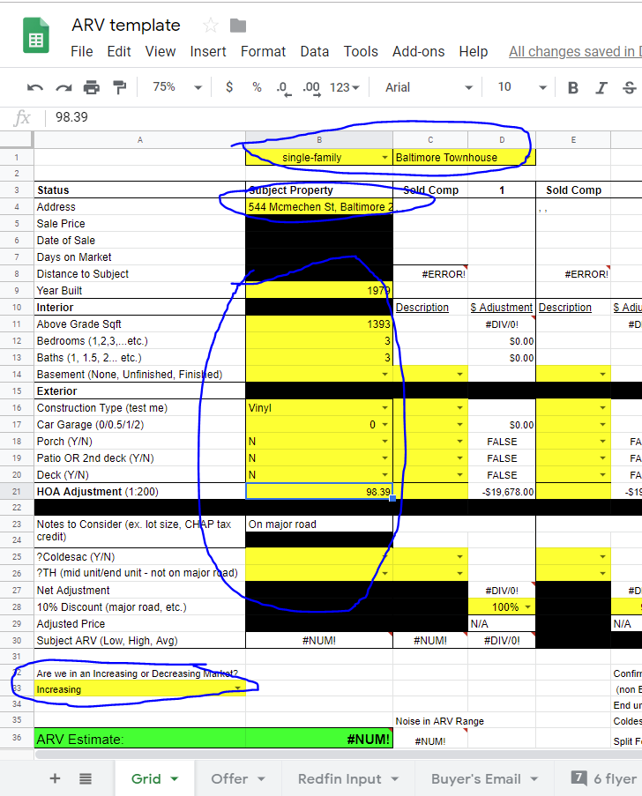
Step 2: Start new ARV Grid
Download ARV Grid from dropbox link
Open ARV copy and fill in the Subject Property Yellow Boxes
Confirm Seller Lead Sheet Property Details:
Redfin (Primary)
Supplements: Zillow, Realtor, Trulia, SDAT
Notes:
(If MLS Access) MLS sheet takes priority for property details.
MLS Comps are most up to date. But Redfin comps are a close 2nd.
However, Redfin/Zillow comps might actually have some off market sales not on the MLS

Slide 5
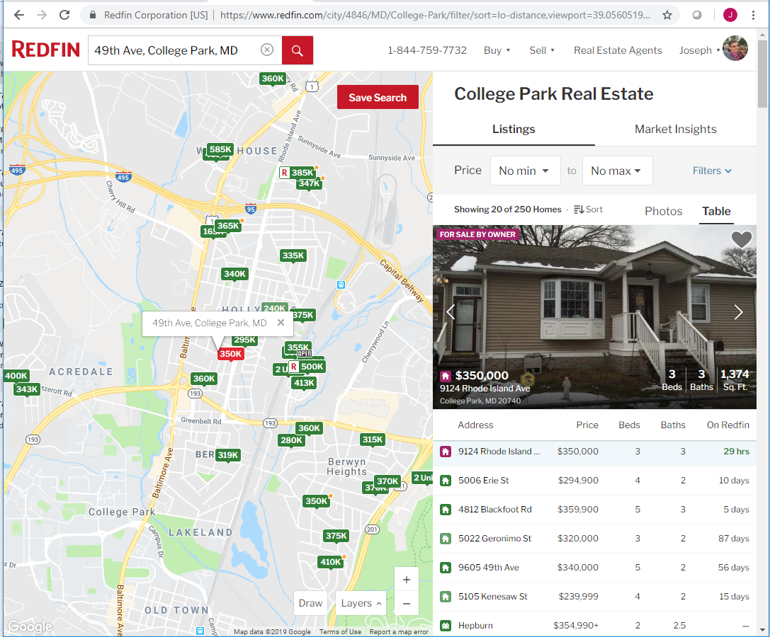
Step 3A: Pull Comps From Redfin. Zoom into the neighborhood
Paste the partial address
"5022 Geronimo St College Park, MD 20740"

Slide 6
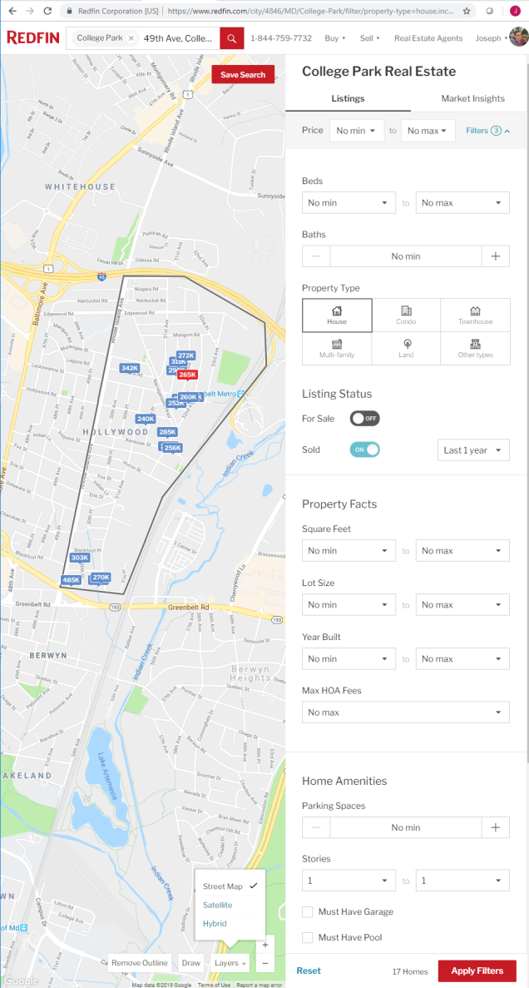
Step 3B: Pull Comps From Redfin. Initial Filter
Sold
For Sale: "Off"
Sold: "Last 1 year"
Property Type
Property Type: "House" or "Townhouse" if Townhouse
Notes:
These filters and others will be tightened in excel outside of redfin. We need a broad dataset to work with.
Filters to skip and why:
SQFT: 25% of subject (Redfin and Zillow data often add basement sqft t total)
Stories: min = max = # of stories. (Redfin data sometimes uses basement as a story. Zillow as alternative?)
Beds + - 1 of target property, never go above/below 3 between comps and subject. (Might eliminate properties with no bed information that could be found on other sites)

Slide 7
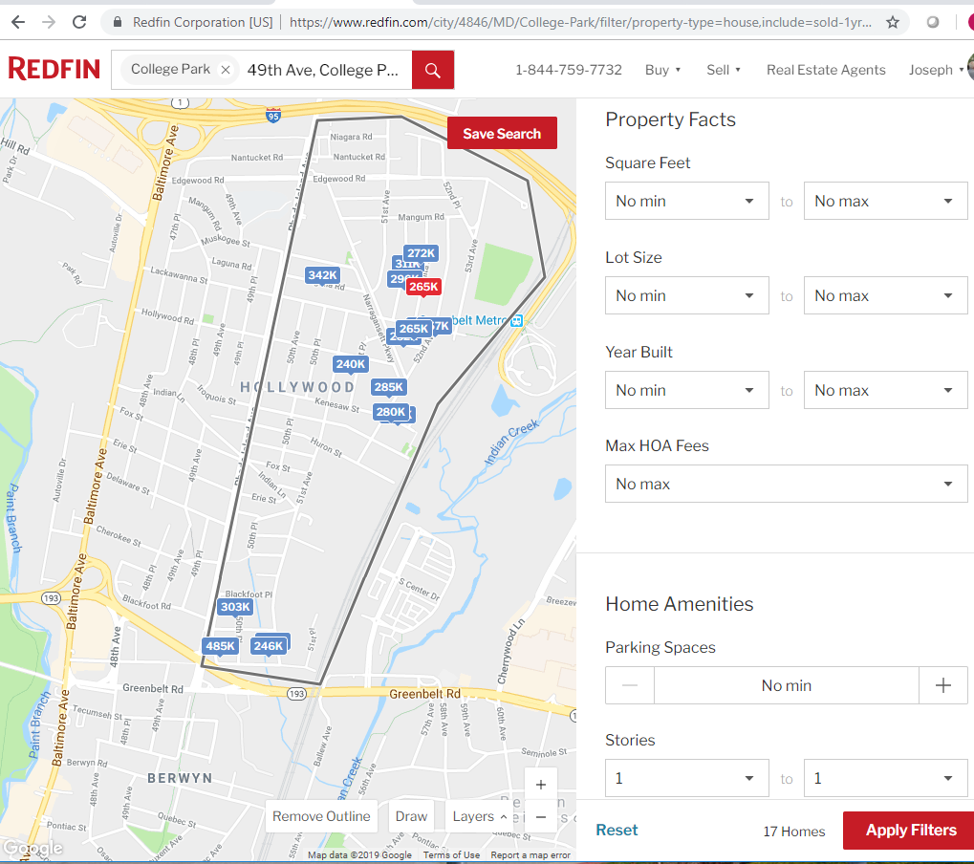
Step 3C: Pull Comps From Redfin. Determine Redfin Search Area
School System Link
Paste Property Address
Zoom in and click different school tags to see their zone
Using the "Draw" tool, select the search area. Stay inside boundaries indicating a change in neighborhoods:
School Districts
Highways
Major roads
Rivers
Notes:
Press "Remove Outline" tool to clear
Same neighborhood. Stay inside major roads or rivers.
Cities could be same street only.
Typically, Suburban comps are less than 0.5 miles.
Rural areas could be several miles.

Slide 8
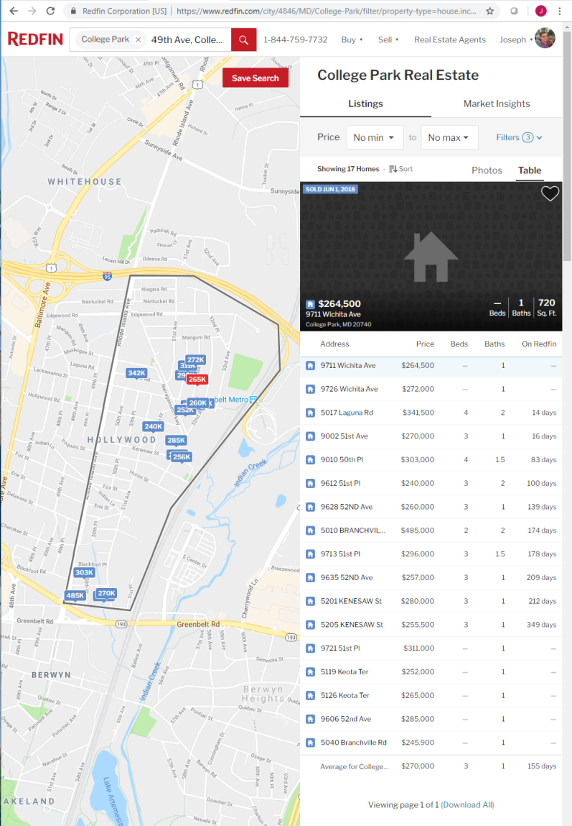
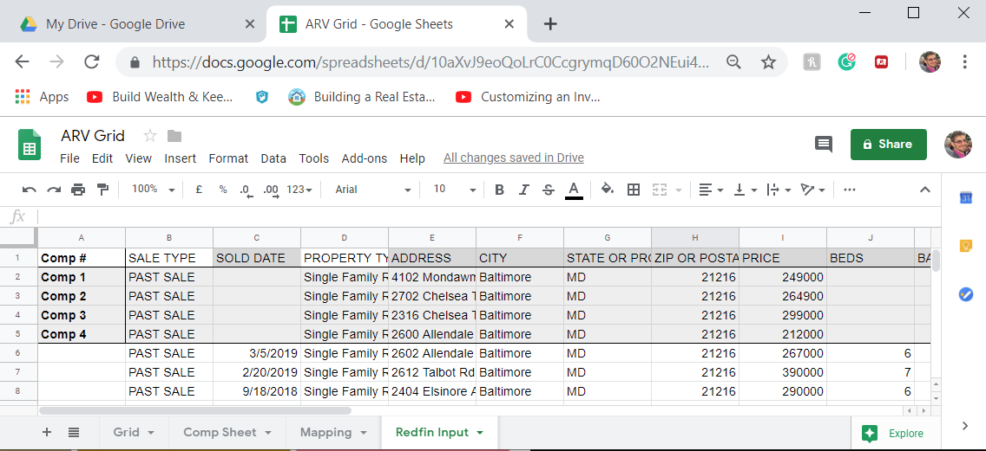
Step 3D: Pull Comps From Redfin. Download
Download the comps from redfin
Copy Paste into ‘Redfin Input’ tab of ARV grid
Paste at cell A10

Slide 9
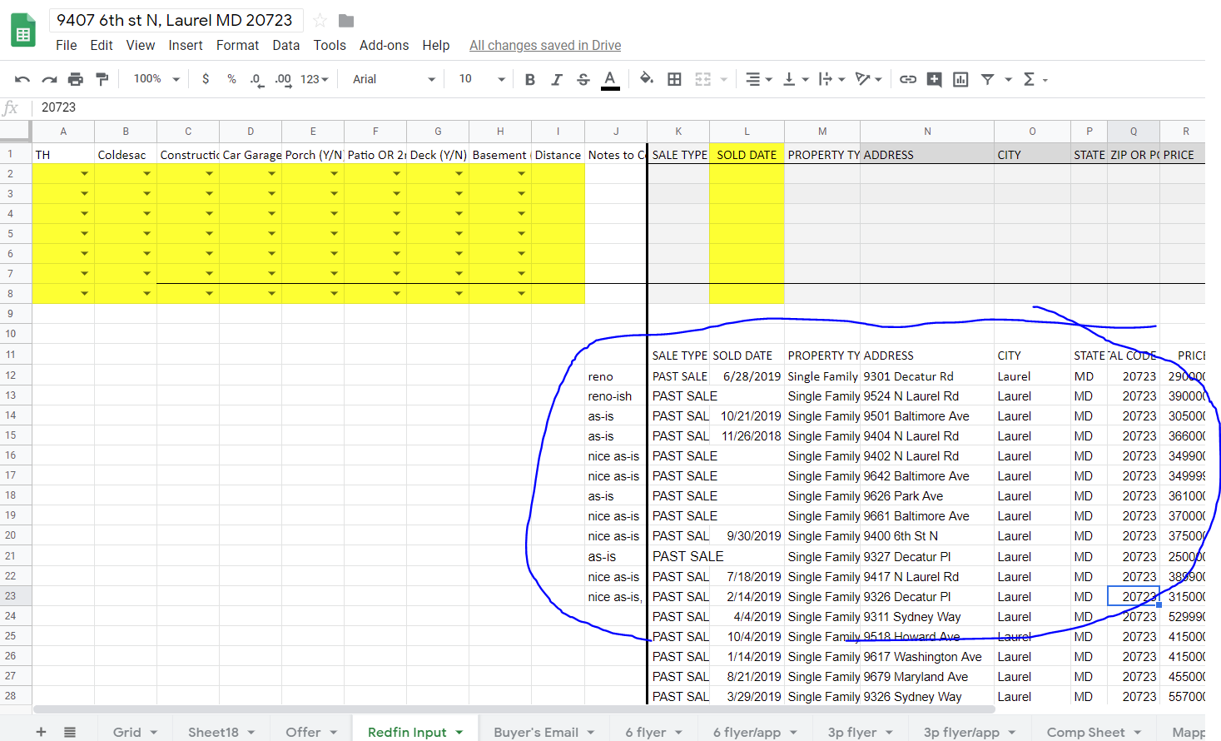
Step 4A Trim Wrong dates/eras/beds/baths (CSV)
Sold Date > 9 months
Era > 25 years
Beds > ± 2 (3 if 5+) of target property
never go below 3 f target property is a 3
Baths > ± 2 (3 if 5+) of target property
never go below 2 if target property is a 2
Don’t delete blank entries yet
Minimum 3 comps.
(If numbers are not tight) the minimum is 5.
Notes:
Minimum 3 comps. (If numbers are not tight) the minimum is 5.
Redfin often labels potential 3-2 properties with blanks for beds and/or baths but these blanks can be filled in with info from other sites like zillow.
ERA: 1930s Colonial vs. 1970s Colonial etc.
Moderate differences in age matter less if older home has been modernized to newer standard.

Slide 10
Step 4B: Trim non-Renos + Update Dates/Eras/Beds/Baths/Sqft
Remove Non-Renovated properties (start with highest prices)
First visit Realtor.com to check for any reno pics
If no reno pics, then Redfin,
Then Zillow, Trulia, etc. until you find a site with renovation pictures to determine status for each address in the CSV file. Still no reno pics after several sites -> remove comp.
Update
blank Sold Dates
blank Beds -> Realtor, Zillow, etc.
Correct Baths -> Realtor, Zillow, etc.
Correct Square Footage (Usually total sqft – basement sqft)
Redfin -> Above Grade Information -> Finished Sq Ft
Zillow -> Above Grade Fin SQFT
Or SDAT-> Above Grade Living Area
Notes:
NEW CONSTRUCTIONs and cleaned-up AS-IS do not count as newly renovated comps.
Conflicting Information Hierarchy: MLS (if available) > Redfin > Zillow > SDAT. (not foolproof)

Slide 11
NOTE.
NEW CONSTRUCTIONs ARE NOT COMPS. (Era rule)
Cleaned-up AS-IS proeprties do not count as newly renovated comps… but don’t delete these yet.

Slide 12
Step 4C: Re-Trim + Tighten Filters
Re-trim: Wrong dates/eras/beds/baths and >25% difference in sqft.
For price outliers, check for and remove:
Massive differences in lot size.
Different Style or “weird” properties
(except for type 2 neighborhoods)
Busy road, gas station, commercial buildings, or trashy/boarded up neighbors.
Crossed out can be accounted for by 10% adjustment, if desperate for comps.
Non Arms-Length Transaction status in SDAT. See SDAT directions in backup.
If more than 6 comps : Tighten in this order:
Sale Date from 9 months to 6 months
Remove different construction types
Tighten in (Distance -> SQFT > Distance) increments:
distance: 1.0, 0.75, 0.5
SQFT difference: 20%, 15%,10%.
Notes:
STYLE: Rancher/rambler/cape cod/townhouse/multiunit/etc.
Type 2 Area: A borderzone area dominated by rentals. Age and style of property matter less here.
Best case, you should be looking for 6 similar comps that have within 10% of the same finished square footage, same number of beds/baths, and sold in the last 3 months.

Slide 13
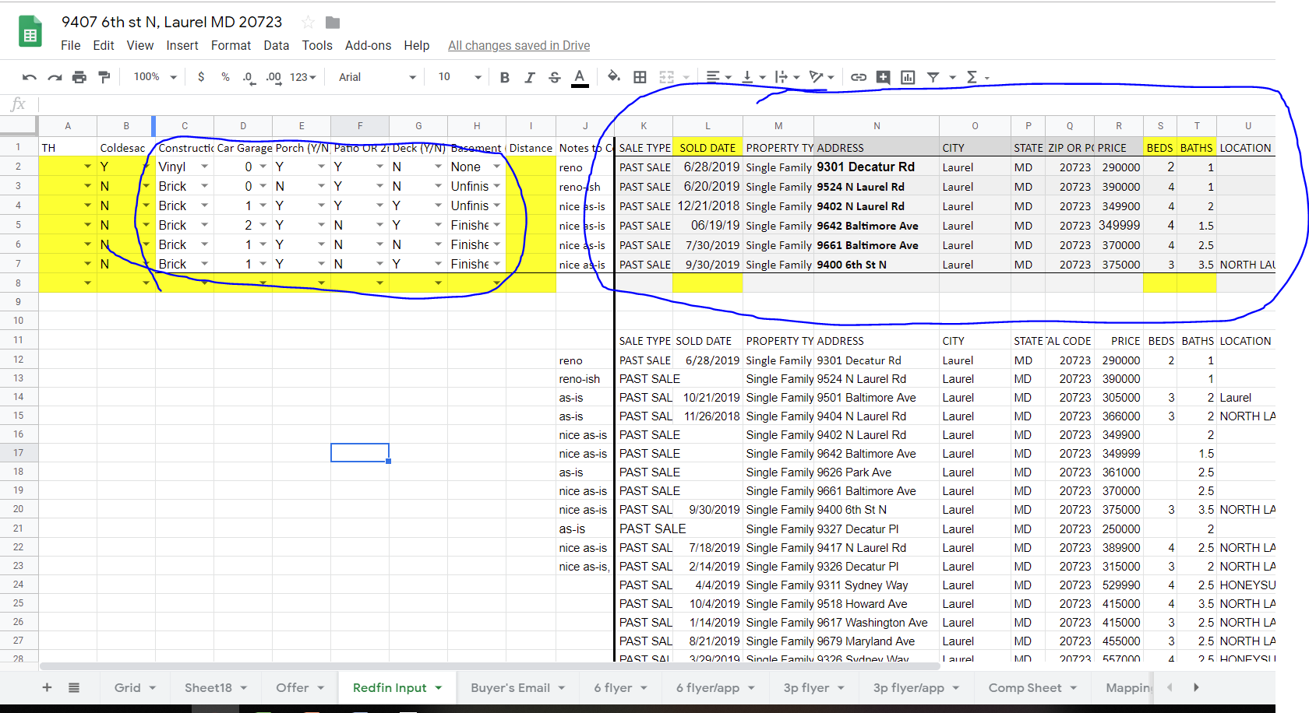
Step 5: Update Comp Details
Copy/Paste as Values to light grey comp area.
Update ‘Grid’ tab details.
(HOA fee -> Zillow)
Baltimore: CHAP Tax Credit.
Estimated CHAP Inflation = (80%ARV-Prior Tax Value)*0.18733333
Notes:
Baltimore Chap Tax Credit: No city property taxes (for first 10 years) on value obtained through renovation.
Conclusion: The Chap Tax Credit is worth 18.7333%* (New Tax value – Old Tax value)
Valuation Details
Estimating value of CHAP tax credit:
Pre-reno tax value = $35k
Post-reno tax value (estimated at 80% ARV) = $340k*0.8 = $272k
Baltimore City Property Tax Rate: 2.248%
1 year of: Taxes saved with CHAP credit: (272k – 35k)*2.248% = $5,327.76
Saved per Month: $5,327.76/12 = $443.98
PV estimate of monthly annuity (freaky accurate estimate): 200:1
200*$443.98 = $88,796
^^ Only 10 years of a 30 year mortgage. Must normalize:
Mortgage interest rate: ~4.5%
$443.98 (rounded to $444) monthly and compounded for 10 years at 4.5% = $66,811
PV of $66,811 at 10 years is: $43,021.45
So in this case, the CHAP credit effectively allows the investor to inflate the price by $43,021.45.
Observation: This amount is almost exactly half of the PV of a 30 year mortgage with the equivalent monthly payment of $443.98 (~48% at 4.5% interest).
-> Quick estimate of price inflation from CHAP tax credit is:
(80%*ARV – Previous Tax Value)*2.248%/2
= (80%*340k – 35k)*2.248%*200/24 = $44,398

Slide 14
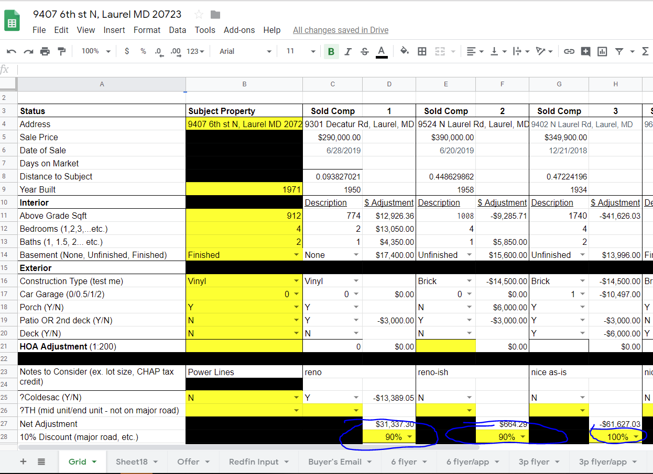
Step 6: 10% Adjustment Check for Final ARV
Remember those AS-IS comps that weren’t renovations but we didn’t remove?
We MIGHT be able to use these with a +10% adjustment IF they were rehabbed within the last two years and do not require any additional repairs
PREFERNCE TO REMOVE THESE COMPS ALTOGETHER.
Buyers might not understand 10% adjustment
Other 10% adjustments if any of the following is true:
Busy road
Junky Neighbors
Commercial business across the street
Lots of stairs to get up to the property
Multiple conditions do not seem to stack.
Notes:
Otherwise identical/perfectly adjusted houses might still be off by 10% if there is something wrong in the immediate area. I don't believe these stack linearly.

Slide 15
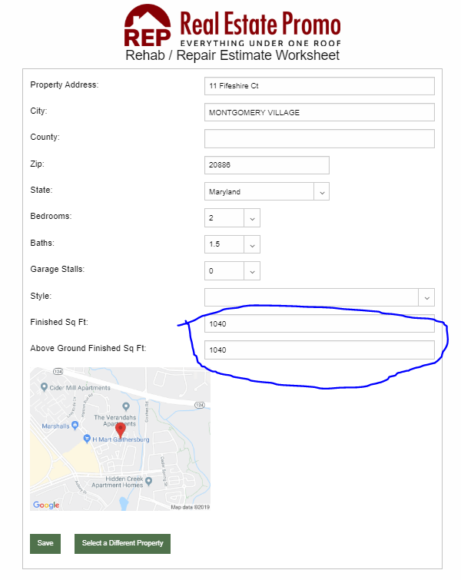
Step 7A: Log in to MAREIA’s Premium Repair Estimator
Log in to MAREIA’s Premium Rehab Estimator:
Enter the above ground SQFT of the property in BOTH boxes (will account for basement later):
Notes:
Conclusion:
Use Above Ground SQFT in BOTH: Above Ground SQFT and Finished SQFT boxes. Basement will be adjusted for later.
Why: The MAREIA calculator adds costs (like external siding) according to the Finished SQFT number, when it should be using the Above Ground SQFT number.
3320 Sudlersville S example:
Full Gut Finished: 2944, Above Ground Sqft: 1472, no 25k: $97,575.00
Full Gut Finished: 1472, Above Ground Sqft: 1472 no 25k: $74,518.00 + 25k = 99,518.

Slide 16
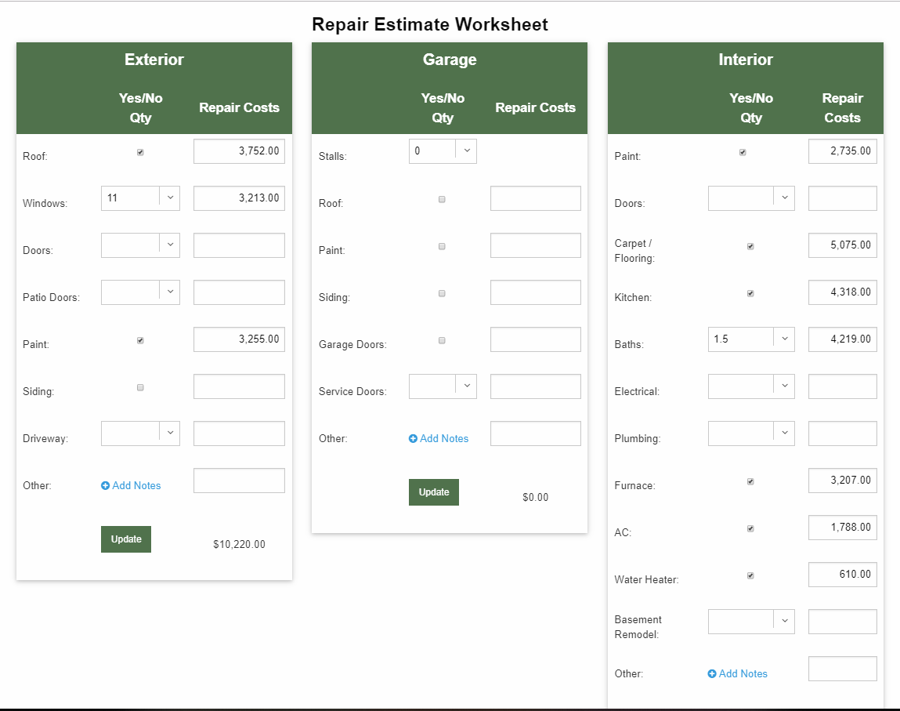
Step 7B: Estimate Main Costs
Use Seller Lead Sheet to determine which repairs need to be made.
If item in question is older than lifespan listed on the Repair Checklist, consider replacing it.
Notes:
Likelihood of repairs assume house flip for retail. Not rental.
Estimated # of interior doors = 2*beds + baths + 3
Highly Likely Interior Repairs
Paint
Carpet/Floor
Kitchen
Bathroom
Furnace
AC
Electrical + Panel
Water heater
Highly Likely Exterior (and garage) Repairs
Roof
Paint (if not siding)

Slide 17
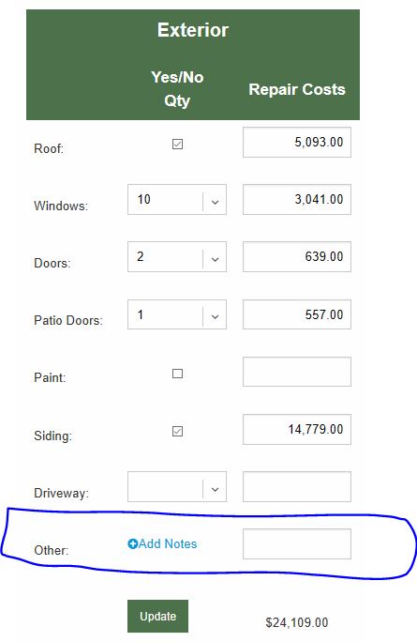
Step 7C: Estimate Porch, Deck or Patio Replacement Costs
Porch range: ~$6000 mid
$15/sqft of porch.
Deck range: ~$6000 mid.
$22/sqft of deck.
Patio range: ~$3000 mid.
$15/sqft of patio.
Landscaping: $1000/tree
Notes:
Porch: ARV and cost numbers copied from Deck. Typically replace decks and renovate porches, so ARV might be 8k, while repair costs are 6k or 4k. TBD.
Average size patio: 16x18 = 288 sqft
Average cost for average patio: 288*15 = $4320
Average Change in ARV for patio: $4320*0.70 = $3024 ~ $3000
Average Size Deck: 12x24 = 288 sqft
(10x12 is considered the minimum)
Average cost for average deck: 288*22= 6336 ~ $6000

Slide 18
Step 7D: Rental vs. Retail Reno
Retail
Rental
Replace a fractured Driveway
Replace HVAC, AC, Electrical Wiring if around end of expected life
Default Plumbing cost: $5,000 ($0 if >1980)
Retain driveways as-is
Keep as-is if functioning: HVAC, AC, Electrical wiring.
Default Plumbing cost: $2,500 ($0 if >1980)
Plumbing goes up by $5,000/$2,500 for Retail/Rental when there is a major repair/water damage that needs to be made or a bathroom added where there was none.
Notes:
Why Plumbing is $2500 for rental and $5000 for retail:
Half of the $5000 is structural work, not technically plumbing, but still results in accurate overall repair estimate.
Alternative to adding a new bathroom where there was none: Simply 2x regular cost to rehab bathroom.

Slide 19
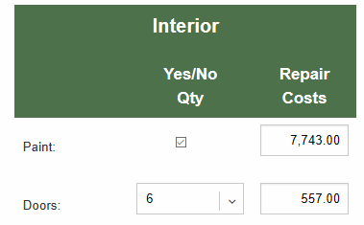
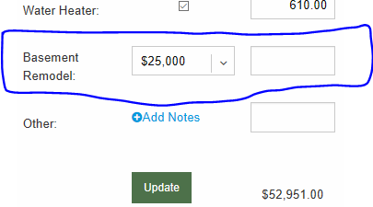
Step 7E: Estimate Interior Space work and Basement Costs
Basement Remodel
Unf -> Fin. Retail: $20,000
Unf -> Fin. Rental: $15,000
Older Fin -> Fin: $10,000
Unfinished Basement: 0$ or $5000 (unconfirmed)
Interior Space Work:
Duct Work: 4k
Tearing out walls: 1k per non-load bearing wall, up to 10k.
…
Notes:
1k per NON load bearing wall, up to 10k for many many walls. (Adding a bedroom DOES NOT COUNT as a major renovation -> $0 extra dollars, included in misc.)
Tearing out load-bearing walls: A LOT of $$. Avoid these properties.
While the cost of a basement can range from $15,000 to $50,000, the median and most commonly seen cost for a typical basement is $25,000. HOWEVER. We have separate budgets for bathrooms and bedrooms that might be in the basement, leading the default retail cost for turning an unfinished (Unf) basement into a finished (Fin) basement for a flip to be 20,000 (15,000 for a rental/really small low type 3 basement).

Slide 20
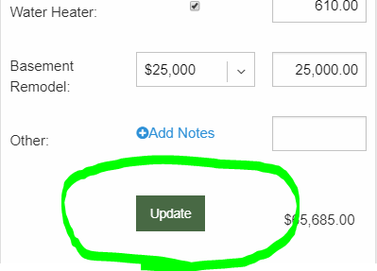
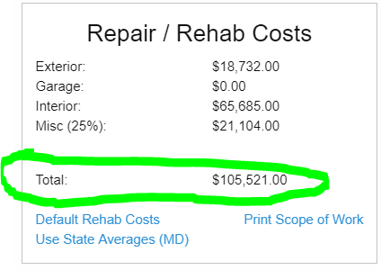
Step 7F: Estimate Costs for Lead Sheet
Click the Update button.
Notes:
Sanity Check:
1990s+: 30/sqft first 1000 + 20/sqft
30/sqft is not too much for rental!!!!
1970s – 1980s: 35/sqft – 55/sqft (Cosmetic)
1950s – 1960s: 55– 75 (Moderate)
- 1940s: 70-100 (Full Gut)
- 1925: Money Pits
Consider also staying away from everything built before WW2 baby boom (-1946)
The MAREIA repair checklists skips foundational estimations for a reason.
You should not be putting those under contract unless you have multiple buyers willing to do that type of work. I don't.
After $80/sqft, its often cheaper to tear down and build a new house anyways.
Permit costs are included in repair estimate as misc.

Slide 21
BACKUP

Slide 22
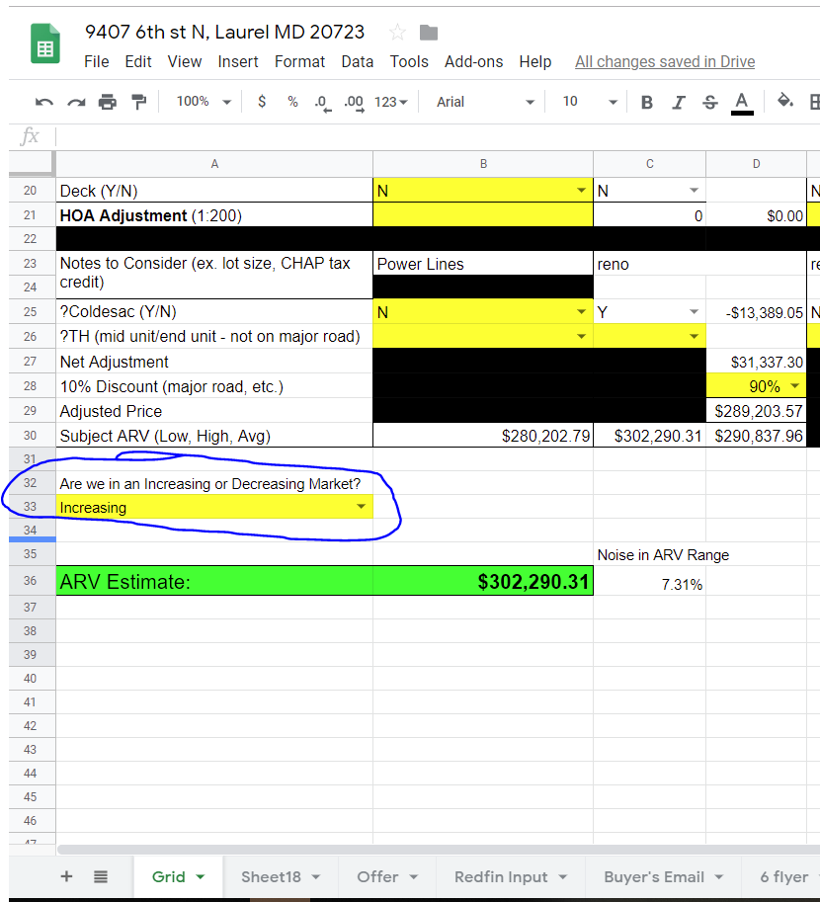
Market adjustment for Final ARV
Select whether we are in an “Increasing” or “Decreasing” national market
Sign of falling market: Lots of new reno comps for sale at lower than ARV price
Write (soft) ARV on Lead Sheet

Slide 23
What to do if there aren’t enough Comps
Get Help: Real Estate Investor, Appraiser
Add Appraisal Contingency
Look at Pending Transactions/For Sale properties. These will consistently be too high.

Slide 24

Check for Non-Arms Length Transactions 1
Go to SDAT
Select County
Search by Address
Click Next

Slide 25
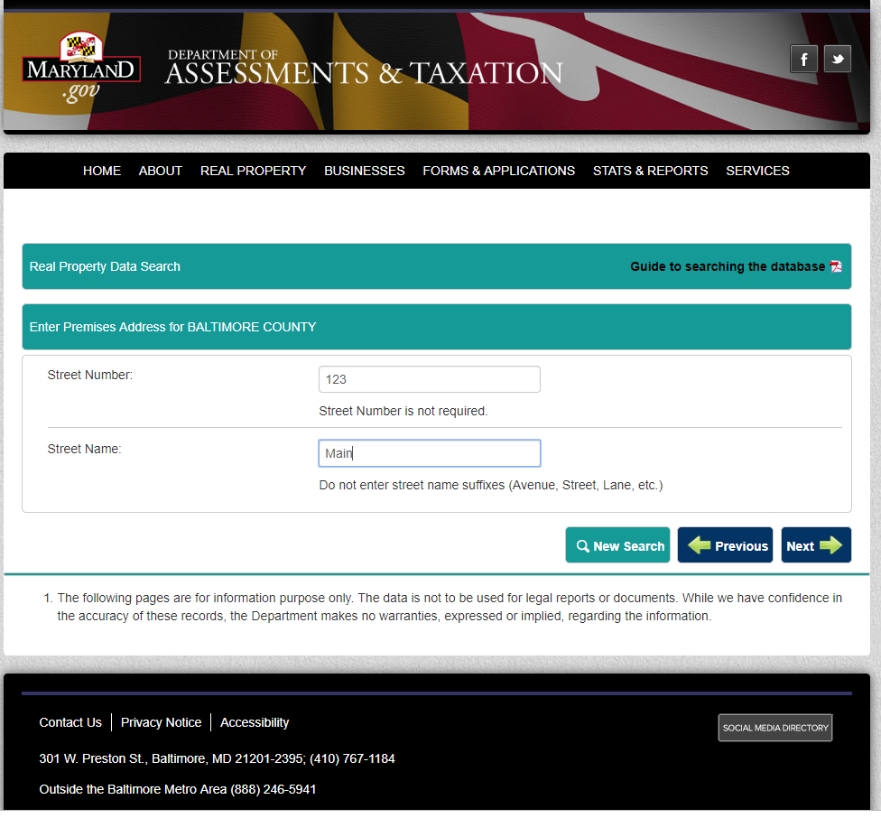
Check for Non-Arms Length Transactions 2
Top Box: Enter only House number
Bottom Box: Enter only street name
No suffixes
123 Main St, Laurel, MD. 20707
Top Box: 123
Bottom Box: Main

Slide 26
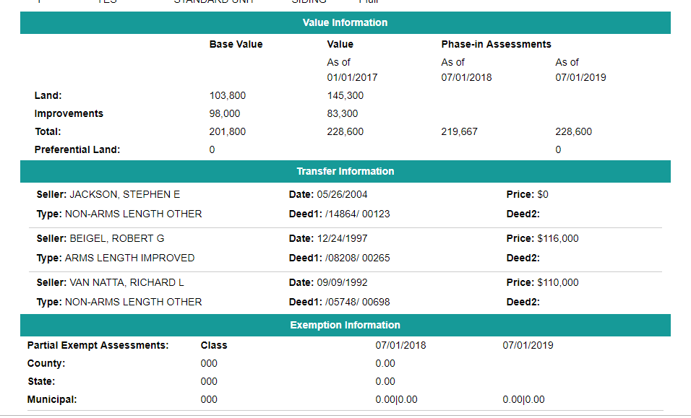
Check for Non-Arms Length Transactions 3
Under 'Transfer Information', see if the most recent transaction
"Arms-Length": Keep
"Non-Arms-Length": Discard

Slide 27
Adjusting Comp differences by percentages
% Adjustments
% Traits
Bedrooms:
6+: 0%
3-5: 1.5% each
<3: Don’t, its not a comp… but if you insist…. 2.25%, maybe.
Bathrooms:
2+: 1% each
<2: If you insist…. 1.5%, maybe.
Basement:
No basement vs. finished basement: 6%
No basement vs. unfinished basement: 2%
Unfinished basement vs Finished basement: 4%
Construction Type:
Vinyl vs Stone/Brick: 5%
Garage:
Street parking vs. offstreet parking: 1%
Street parking vs 1 car garage: 3%
Street parking vs. 2 car garage: 5%
Baltimore only:
Street parking vs. anything that’s not street parking: extra 1%
Sqft adjustments:
(Comp $/sqft)*(sqft difference) / 4.0
if baltimore:
divide by 2.0 instead
0% adjustments:
Pool
Attic
Currently experimenting:
Coldesack vs. Street
End Townhouse unit vs interior Townhouse unit
Notes:
Update as needed.

Slide 28
Adjusting Comps Other % traits
?% Traits
0% Traits
Lot size?
Coldesacks vs street?
Not on Public Utilities: ?
Zoned Use: ?
Entry Halls: ?
Laundry Rooms: ?
Age: ?~0.4% per year ?
Pools: ~ 0%
Attic Storage: ~0%
Notes:
Update as needed.

Slide 29
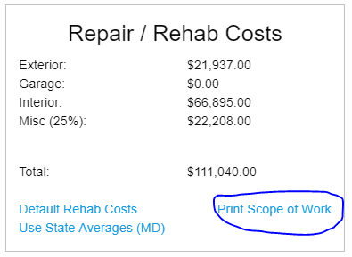
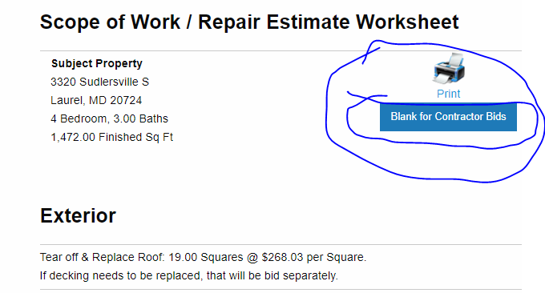
Print Scope of Work(s)
Print a Scope of Work (costs included)
Print a Scope of Work (costs blanked out)
Add both Scope of Work(s) to Property Clipboard

Slide 30
Commercial and Rental ARV
ARV determined by NOI / Local Cap Rate
NOI = (Gross Rent – Operating Expenses)*12
Operating Expenses = ~35% Rent + Taxes/Insurance/HOA fees.
Baltimore cap rates: link
Alternative method: Work backwards using recently sold rentals in little to no repair condition.
Notes:
Operating Expenses: About 35% Rent + Taxes/Insurance/HOA fees.
Cash flow = NOI - mortgage
Townhouse units are not a direct comparison with quadplex units. However, when valuating based on rent their rent/price ratios are nearly identical. Baltimore per unit rental valuation: rent*0.45*12/.0625 = ARV. Waterbill in baltimore city closer to 40-60/month.

Slide 31
4 levels of Renovation (PG County)
Total Building Area = Living Area + Basement Area
Rental Grade $15/sqft:
Paint + Carpet, and minor repairs
You will be competing with homeowners for retail properties on this rehab level.
Simple Rehab $35-$40/sqft ($30-$35 for Townhouse):
Replace fixtures in existing locations
Kitchen, Bathroom, Carpet + Paint, Floowing
1 major system of about $5k (roof, AC, etc.)
Basic Remodel $55-$60 ($40-$45 for Townhouse):
^^ +
1-2 walls
Plumbing/Electric to reconfigured bathrooms,kitchens
~$10k for major system(s)
Extensive Remodel $75-$80 ($55-$60 for Townhouse):
^^ + Roof, HVAC, deck/porch
Significant framing work
Kitchen and Basement remodels, additional beds/baths
Plumbing/Electric overhaul to support
Notes:
Cosmetic rehabs is anything that doesnt involve taking a wall out or replacing a mechanical.
Cosmetic: bathrooms, kitchens, siding, and landscaping.
Numbers obtained from Upper Marlboro meet up in early 2019.

Slide 32
Properties with foundational work will sell IF:
You have a long buyer list with specialists that will tackle foundational work
You double the expected repair costs as a buffer
You add a hefty contingency clause for the buyer
Its a Hot Market

